Slide 1

NETFLOW

Slide 2
FLOW
To fully understand what NetFlow is and why it’s used for network monitoring, we first need to know what a flow is.
When computers need to talk to one another they establish communication channels, commonly referred to as connections. A flow refers to any connection or connection-like communication channel.
In more technical terms, a flow is defined by its 5-tuple, a collection of five data points:
Source and destination IP addresses exchanging information
Source and destination ports, if any (ICMP, for example, doesn’t use ports)

Slide 3
Netflow
NetFlow is functionality built into network devices that collects measurements for each flow and exports them to another system for analysis. For example, NetFlow captures the timestamp of a flow’s first and last packets (and hence its duration), the total number of bytes and packets exchanged, a summary of the flags used in TCP connections, and other details.
By collecting and analyzing this flow data, we can learn details about how the network is being used. For example, flow analysis is helpful in troubleshooting network issues, identifying bandwidth hogs, and tracking which external IPs or countries you’re exchanging data with.

Slide 4
The Evolution f Netflow
NetFlow was originally introduced in Cisco routers as a way to summarize network flow data for packets routed over Cisco equipment. It was first introduced in 1995 as a software-based technique for use on LANs but it didn’t scale well for high-bandwidth connections and was eventually replaced by another technique called express forwarding.
Cisco realized, however, that having network flow data was very useful and implemented NetFlow in hardware instead.
Over the years, NetFlow has become the de facto industry standard that other vendors have imitated. To avoid trademark issues, other vendors have given their flavor of flow analysis different names. For example, Juniper offers J-Flow, Huawei offers NetStream, and sFlow is a multi-vendor offering.

Slide 5
Netflow is Typically used to:
Know the network at any time and any point
Monitor network traffic in real-time
Secure the network against internal and external threats
Track the historical data and drill-down to any host, application or conversation
Analyze the network flows for efficient capacity planning and traffic engineering
Fulfill the data retention law (lawful intercept)

Slide 6
Netflow is Typically used to:
Troubleshoot the network failures fast and precisely
Introduce intelligent traffic and financial reporting
Plan and monitor QoS policy in detail
Check the peering and service level agreements (SLA)
Introduce IP based billing and accounting
Find out who are the top users and get their statistics

Slide 7
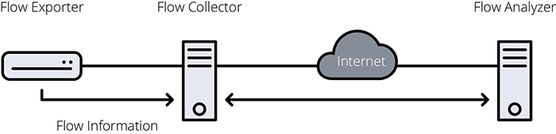
How does NetFlow work?
Using NetFlow requires three pieces:
Flow exporter: an appliance or network device (usually a router or firewall) in charge of collecting flow information and exporting it to a flow collector.
Flow collector: an appliance or server that receives exported flow information.
Flow analyzer: an application that analyzes flow information collected by the flow collector.

Slide 8
How does NetFlow work?
Generating NetFlow data starts at the network device when a packet arrives. First, the device checks if the packet’s 5-tuple is present in a table of recently seen flows called the flow cache.
If the 5-tuple is in the table, the cache entry is updated: packet count is incremented by one, byte count is increased by packet length, and so on. If the flow isn’t in the cache, it means the packet belongs to a previously unseen flow, so a new entry is added to the table.
Of course, the whole point of NetFlow is to export information to a collector for storage or analysis. For this reason, the flow information is periodically exported to the flow collector in a process known as flow expiration.

Slide 9
NetFlow gives you deep network visibility
Flow analysis tools are the most commonly deployed network visibility tools in the service provider world. Alternatives include deep packet inspection, which tends to be overkill on most client networks, and active monitoring, which as the name implies introduces an unnecessary load on the network.
The biggest advantage to using flow analysis is that you almost certainly have NetFlow or IPFIX support on your client devices already— you simply need to activate it and point its output to a collector.
Installing flow analysis is easy and relatively inexpensive. Extra hardware is almost never needed. Configuration is limited to a few nodes on the network and can be completed in a few minutes with zero downtime.
This means you can quickly add flow analysis to a client network and instantly gain vital insights into all traffic flows.

Slide 10
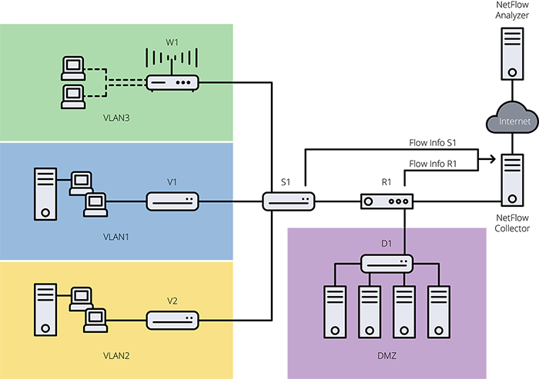
NetFlow gives you deep network visibility
In the example below, configuring NetFlow on the main router connected to the internet (R1) lets you monitor all the traffic in and out of the company, and to watch for any attacks on the servers in the DMZ. This is typically referred to as north-south traffic.

Slide 11
NetFlow gives you deep network visibility
If you enable NetFlow on the main switch connecting the different departments (S1), you also gain instant visibility into all internal network traffic as well, typically referred to as east-west traffic.
In sum, NetFlow is a powerful tool for monitoring any network. With its simplicity and ability to inexpensively collect a wide array of detailed metrics, you can use NetFlow to inspect, assess, plan, troubleshoot and secure all your client networks.
The protocol allows you to really drill down into your network traffic to see where the traffic source is coming from and to where it is destined too when troubleshooting slow LAN or WAN network connections. The protocol itself does not analyze the traffic, but as mentioned previous, when configured properly it sends traffic to a Collector or Analyzer, which is either a hardware device or more often than not, a software program.
By analyzing the data provided by NetFlow, a network administrator can determine things such as the source and destination of traffic, class of service, and the causes of congestion.

Slide 12
Nfsen (Netflow Sensor)
NfSen is a graphical web based front end for the nfdump netflow tools. NfSen allows you to:
Display your netflow data: Flows, Packets and Bytes using RRD (Round Robin Database).
Easily navigate through the netflow data.
Process the netflow data within the specified time span.
Create history as well as continuous profiles.
Set alerts, based on various conditions.
Write your own plugins to process netflow data on a regular interval.
Different tasks need different interfaces to your netflow data. NfSen allows you to keep all the convenient advantages of the command line using nfdump directly and gives you also a graphical overview over your netflow data.

Slide 13
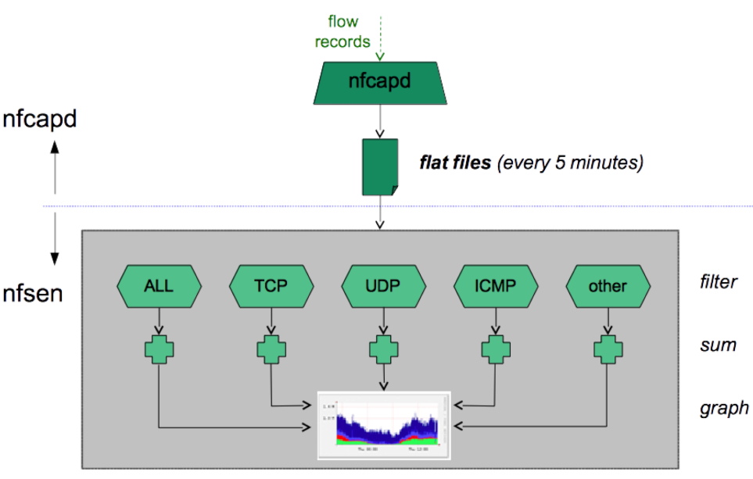
Nfsen Architecture

Slide 14
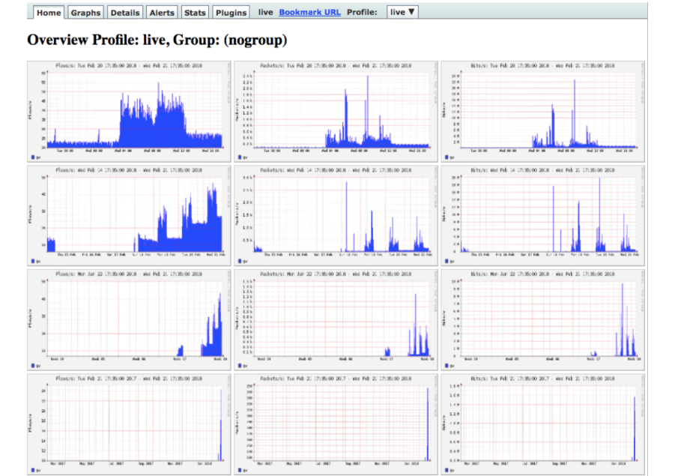
NFSEN HOME SCREEN

Slide 15
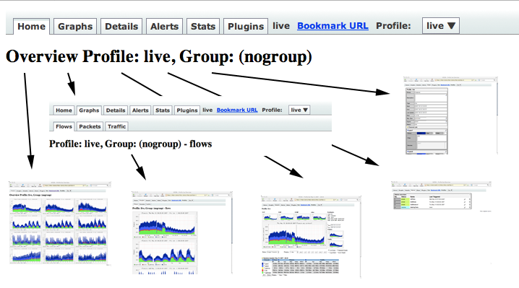
Tab Navigation

Slide 16
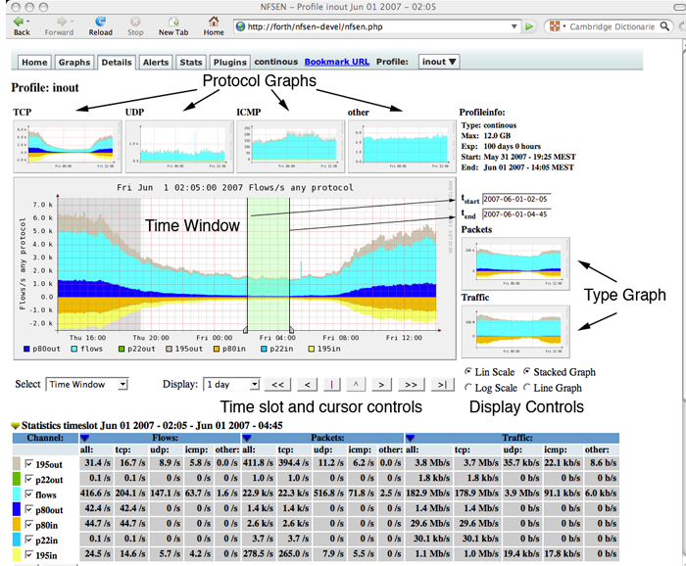
Flow Navigation

